Slide 1

My Clubcard Account
(MCA)

Slide 2
What is MCA?
MCA (My Clubcard Account) is a loyalty web application for customers.
MCA enable customers to engage with Tesco and grow their loyalty.
Allows customers to manage their online account from a single place
Customers can manage their contact preferences, dietary preference and point accumulation, can opt out/opt in of certain marketing messages.

Slide 3
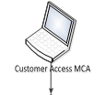
Architecture
WebLayer
ServiceLayer
NGC Database

Slide 4

Deployment View

Slide 5
Deployment Process
MCA it deployment involves three stages before it lands in production
Stage1 : Deployment to INT
This involves raising an RFC to the Change and Configuration(C&C) team who will perform the deployment. If any PLC changes are involved developer performs deployment. RFC is to be approved by dotcom service manager
Stage2 : Deployment to OPS
This involves raising an RFC to the Change and Configuration(C&C) team who will perform the deployment. If any PLC changes are involved developer performs deployment. RFC is to be approved by dotcom service manager
Stage3 : Deployment to Production
This involves raising a CM in ICCM tool which includes details of the job for the corresponding teams. If any PLC changes are involved support teamperforms deployment. CM is to be approved by Change Owner.

Slide 6
8 Golden Rules
Is the solution simple to explain? If you can’t describe it in a couple of tweets it’s too complicated.
Will it deliver what all international customers’ need?
Why can’t we extend an existing solution to deliver this change?
The business changes over time, have we made the solution flexible to avoid rework? How does it cater for local country differences?
Can we deploy it once, scaling and extending simply and quickly for the group?
Imagine it’s 2am and you’ve just been called up because the solution you designed has failed. If you were the support team looking after this, is it quick to determine the root cause and fix?
Will users be impressed by a slick, channel independent, coherent user experience?
Are you proud of what you have delivered? If you needed it, would you be happy to pay for it with your own money?

Slide 7
MCA Application walkthrough

Slide 8
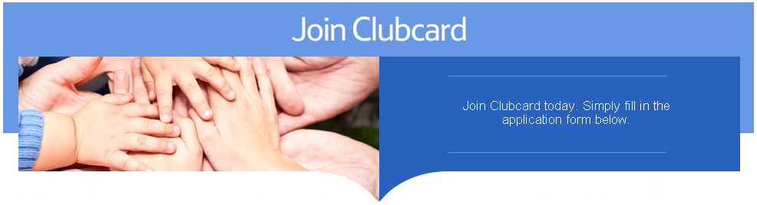
ONLINE JOIN CLUBCARD

Slide 9
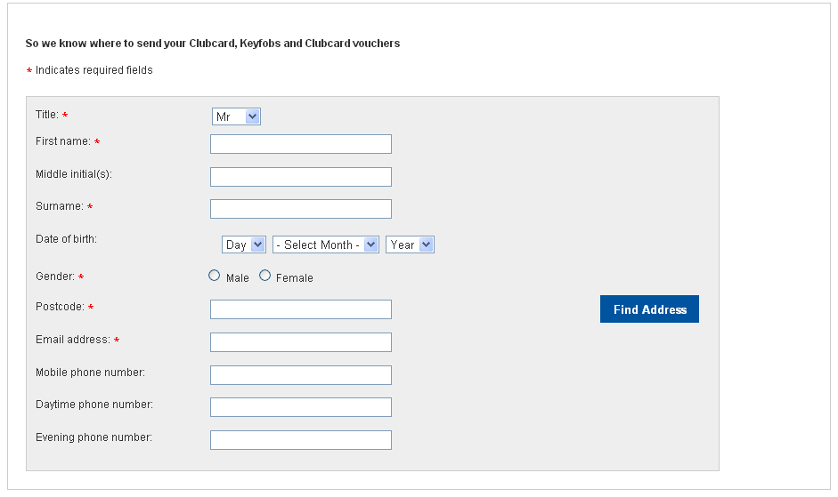
Customer Details
Address fields will appear for Thailand
Option to configure the fields as Mandatory

Slide 10
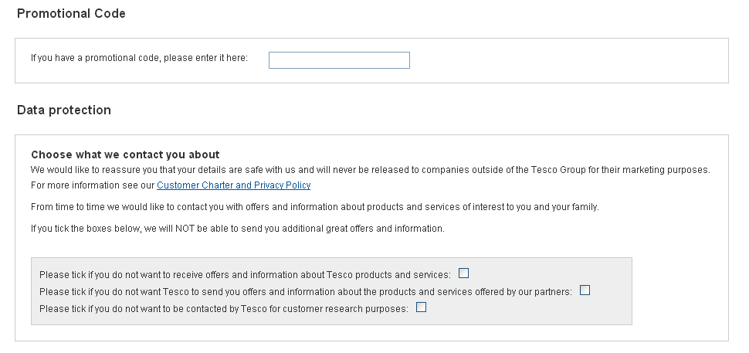
Data protection preferences
Promotion code for Join Campaign
Data Protection Preferences

Slide 11
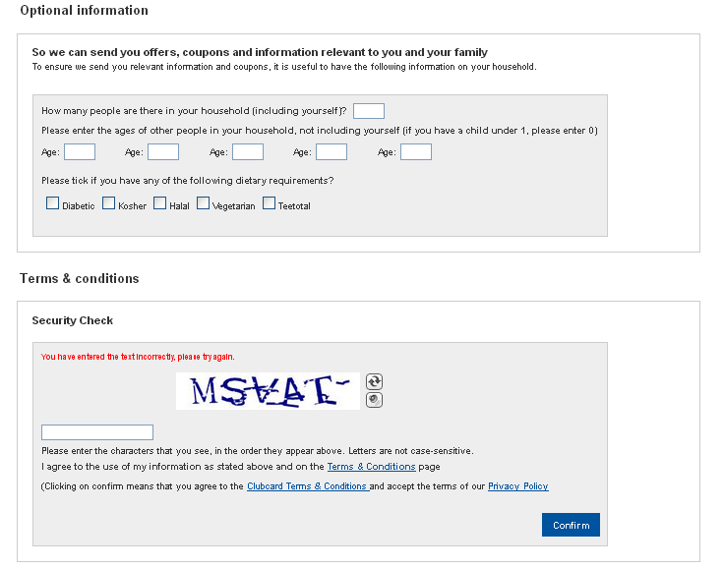
Submit the form
Dietary Preferences & Family Details
Security Check & Confirmation

Slide 12
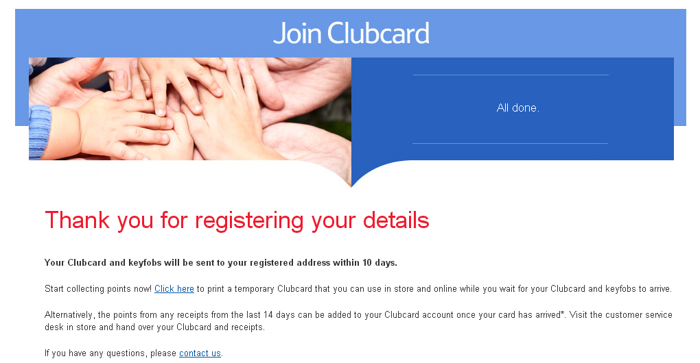
Registration Complete

Slide 13
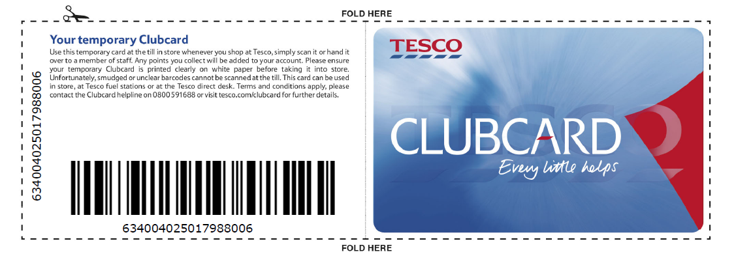
Submit the form

Slide 14
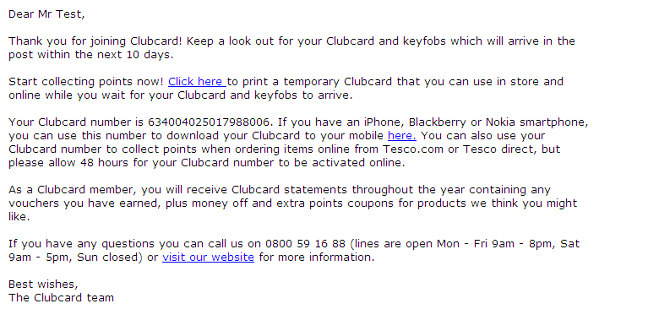
Email confirmation

Slide 15
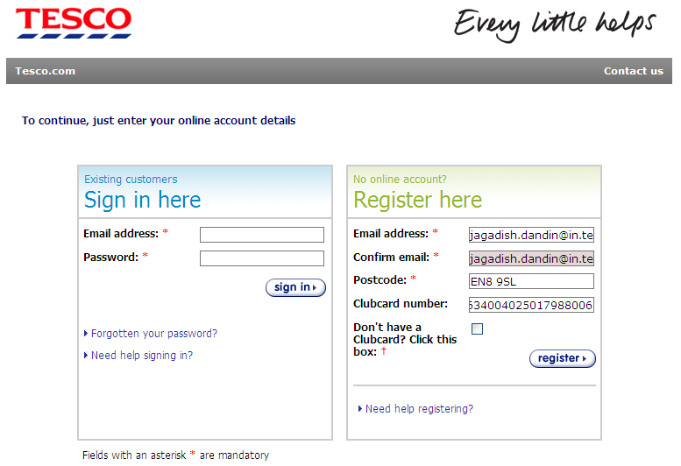
Register for Online account

Slide 16
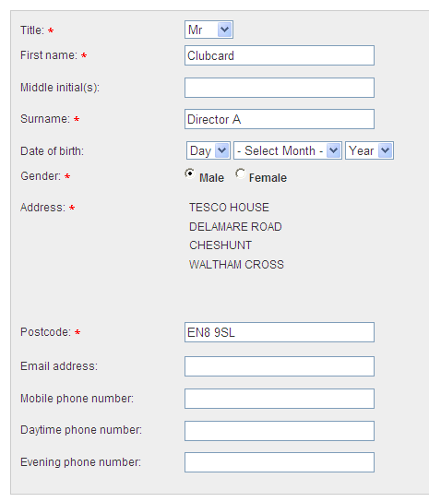
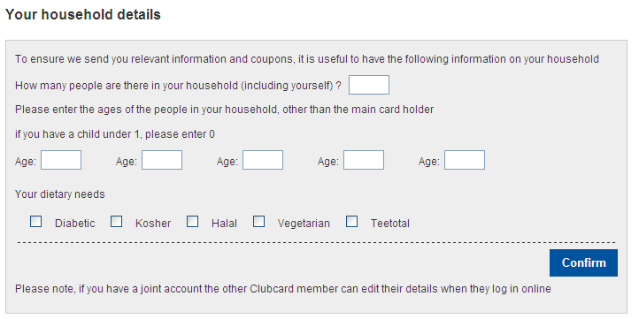
Personal Details

Slide 17
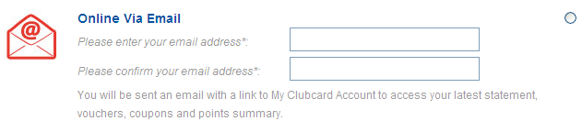
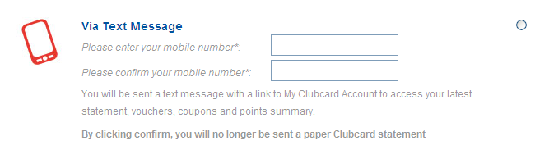
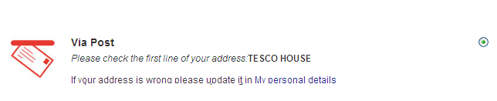
My preferences for mailing statement

Slide 18
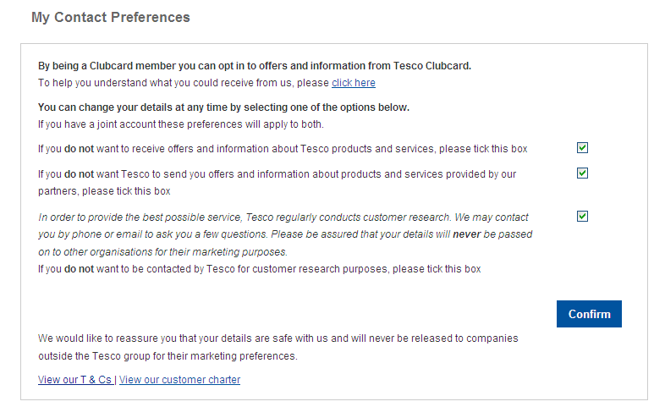
My preferences for contact

Slide 19
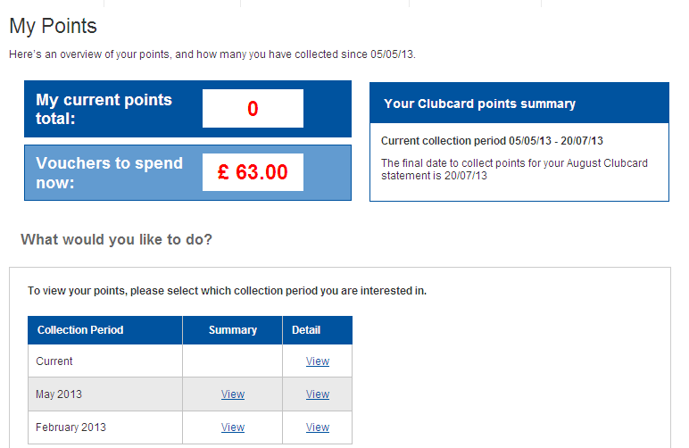
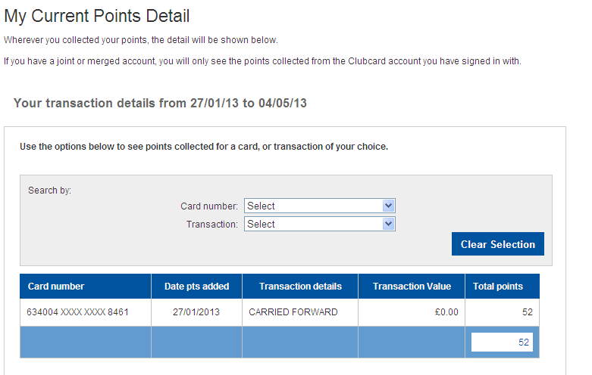
My Points

Slide 20
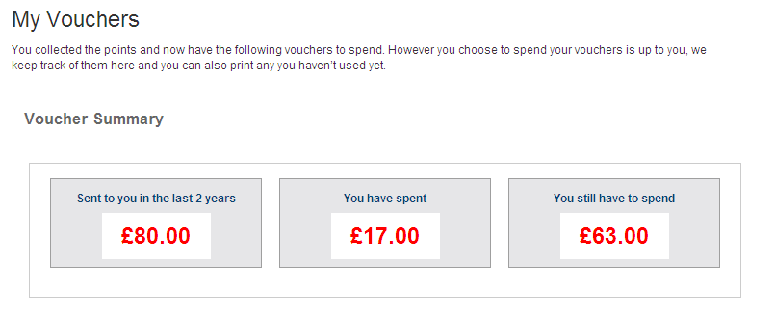
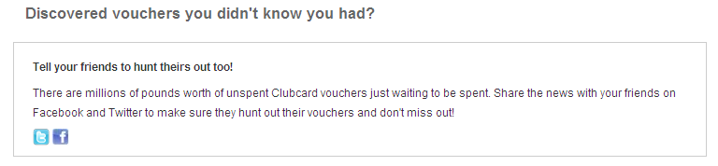
Vouchers
Facebook and Twitter Integration

Slide 21
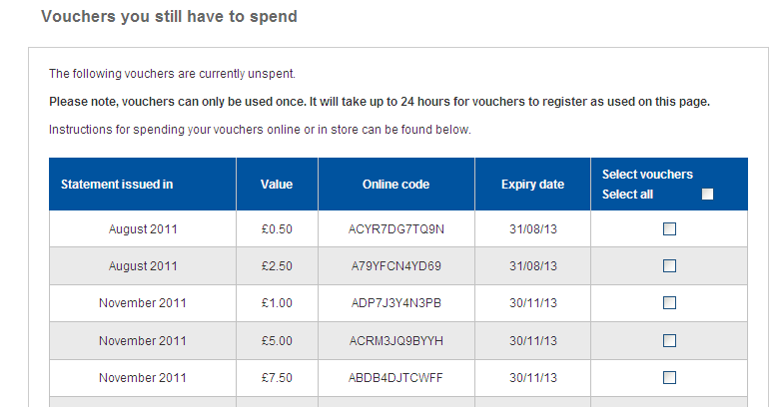
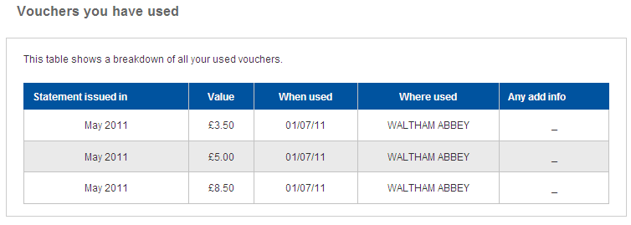

Vouchers

Slide 22
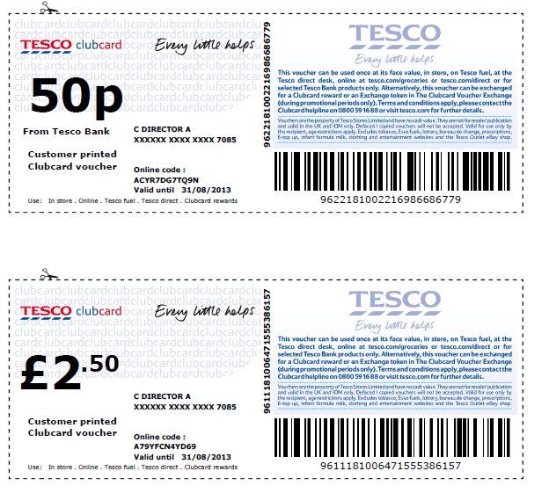
Print Vouchers @ Home

Slide 23
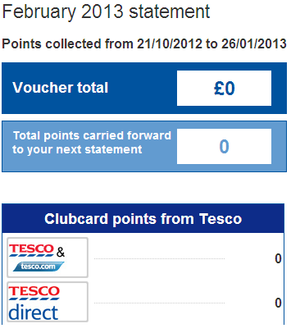
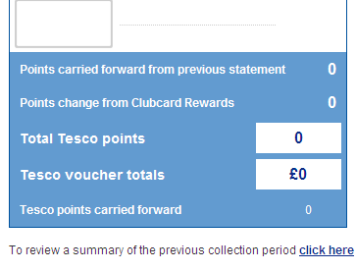
My latest statement

Slide 24
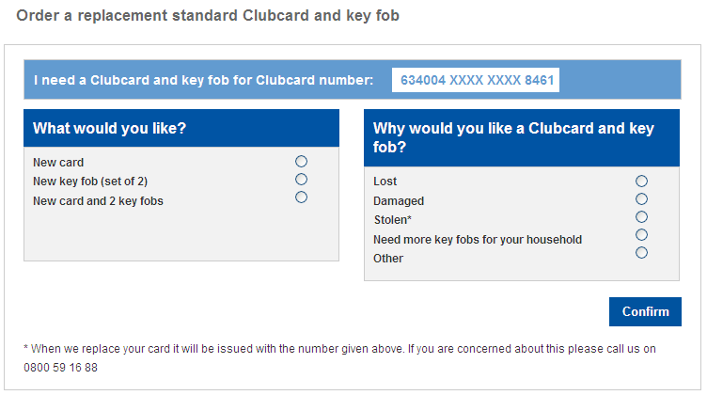
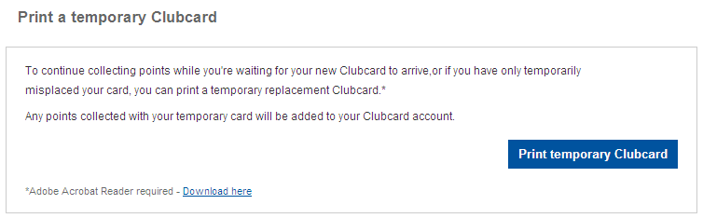
Order a Replacement Card

Slide 25
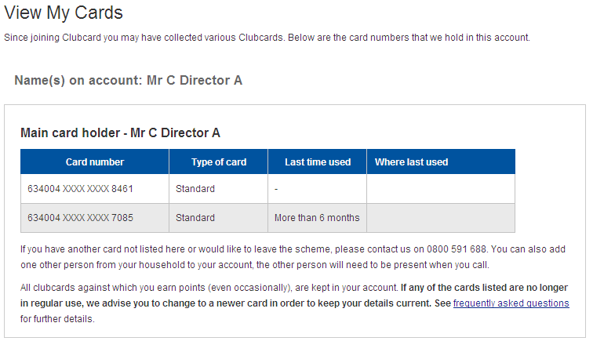
View My Cards

